Slide 1

Verification and tools in Event-B modelling
Mike Poppleton
users.ecs.soton.ac.uk/mrp
Slides adapted from Prof. Michael Butler,
Marktoberdorf Summer School 2012

Slide 2
Overview
Abstraction & refinement
validation & verification
Proof obligations in Event-B
Rodin tool features
Notes:
Jean-Raymond told me to emphasise abstraction

Slide 3
Problem Abstraction
Abstraction can be viewed as a process of simplifying our understanding of a system.
The simplification should
focus on the intended purpose of the system
ignore details of how that purpose is achieved.
The modeller/analyst should make judgements about what they believe to be the key features of the system.

Slide 4
Abstraction (continued)
If the purpose is to provide some service, then
model what a system does from the perspective of the service users
‘users’ might be computing agents as well as humans.
If the purpose is to control, monitor or protect some phenomenon, then
the abstraction should focus on those phenomenon
in what way should they be controlled, monitored or protected?

Slide 5
Refinement
Refinement is a process of enriching or modifying a model in order to
augment the functionality being modelled, or
explain how some purpose is achieved
Facilitates abstraction: we can postpone treatment of some system features to later reﬁnement steps
Event-B provides a notion of consistency of a reﬁnement:
Use proof to verify the consistency of a reﬁnement step
Failing proof can help us identify inconsistencies

Slide 6
Validation and verification
Requirements validation:
The extent to which (informal) requirements satisfy the needs of the stakeholders
Model validation:
The extent to which (formal) model accurately captures the (informal) requirements
Model verification:
The extent to which a model correctly maintains invariants or refines another (more abstract) model
Measured, e.g., by degree of validity of proof obligations

Slide 7
Event-B verification and tools

Slide 8
Event-B modelling components
machine m
variables v
invariants I
events e1, e2, …
context ctx
sees
sets s
constants c
axioms x
sees
machine m1
context c1
refines
extends
sees
machine m2
context c2

Slide 9
Event structure
E = \\ event name
any
x1, x2, … \\ event parameters
where
G1 \\ event guards (predicates)
G2
…
then
v1 := exp1 \\ event actions
v2 := exp2
…
end

Slide 10
Role of Event Parameters
Most generally, parameters represent nondeterministically chosen values, e.g.,
NonDetInc =
any d where v+d ≤ MAX then v:=v+d end
Event parameters can also be used to model input and output values of an event
Can also have nondeterministic actions:
when v<MAX then v :| v < v’ ≤ MAX end

Slide 11
Refinement for events
A refined machine has two kinds of events:
Refined events that refine some event of the abstract machine
New events that refine skip
Verification of event refinement uses
gluing invariants linking abstract and concrete variables
witnesses for abstract parameters

Slide 12
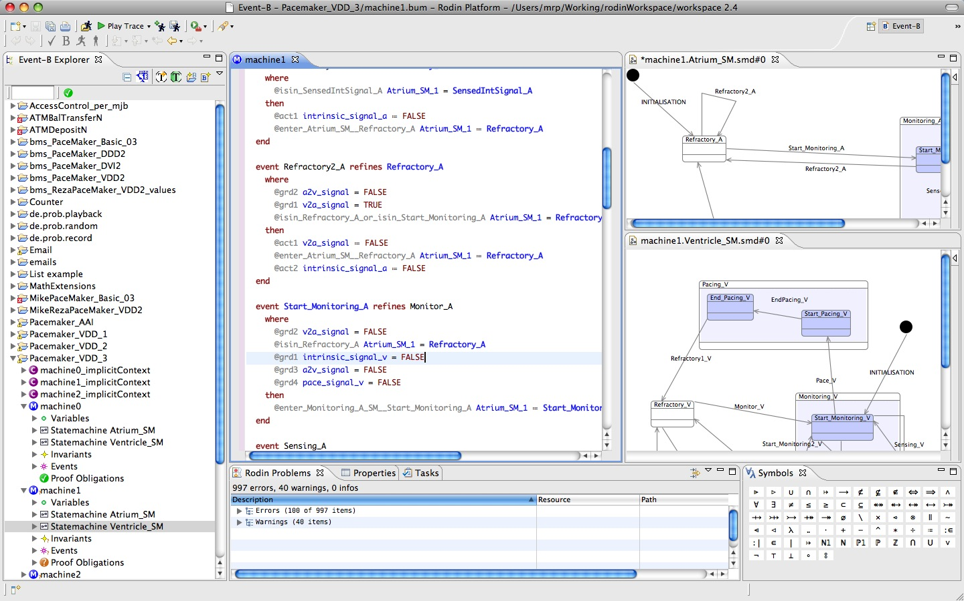
Rodin: Event-B perspective: model text, explorer, statemachine views:

Slide 13
Proof obligations in Event-B
Well-definedness (WD)
e.g, avoid division by zero, partial function application
Invariant preservation (INV) ***
each event maintains invariants
Guard strengthening (GRD) ***
Refined event only possible when abstract event possible
Simulation (SIM) ***
update of abstract variable correctly simulated by update of concrete variable
Convergence (VAR)
Ensure convergence of new events using a variant

Slide 14
Invariant Preservation
Assume: variables v and invariant I(v)
Deterministic event:
Ev = when P(v) then v := exp(v) end
To prove Ev preserves I(v):
INV: P(v), I(v) ⊢ I( exp(v) )
This is a sequent of the form Hypotheses ⊢ Goal
The sequent is a Proof Obligation (PO) that must be verified

Slide 15
Using Event Parameters
Event has form:
Ev = any x where P(x,v) then v := exp(x,v) end
INV: I(v), P(x,v) ⊢ I( E(x,v) )

Slide 16
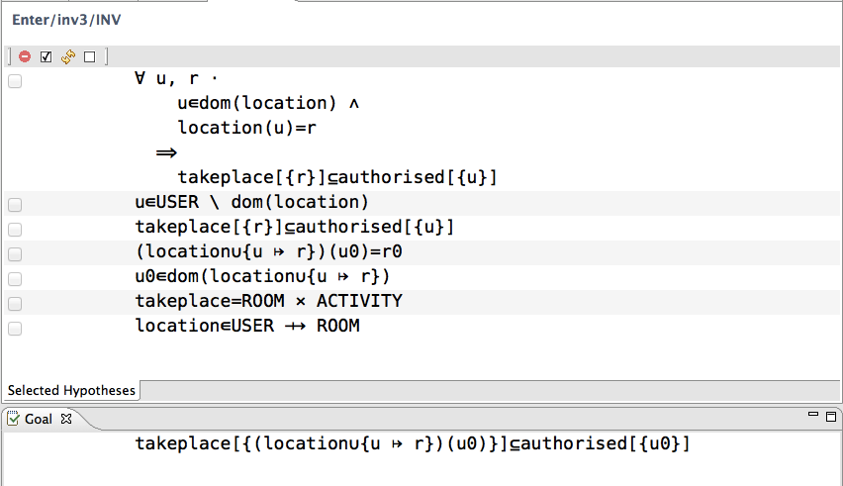
Example PO from Rodin

Slide 17
How do we know what to prove?
Need for proofs imposes proof obligations
the user does not have to state them
they are automatically generated by a tool
Proof obligations serve to
verify properties of a model

Slide 18
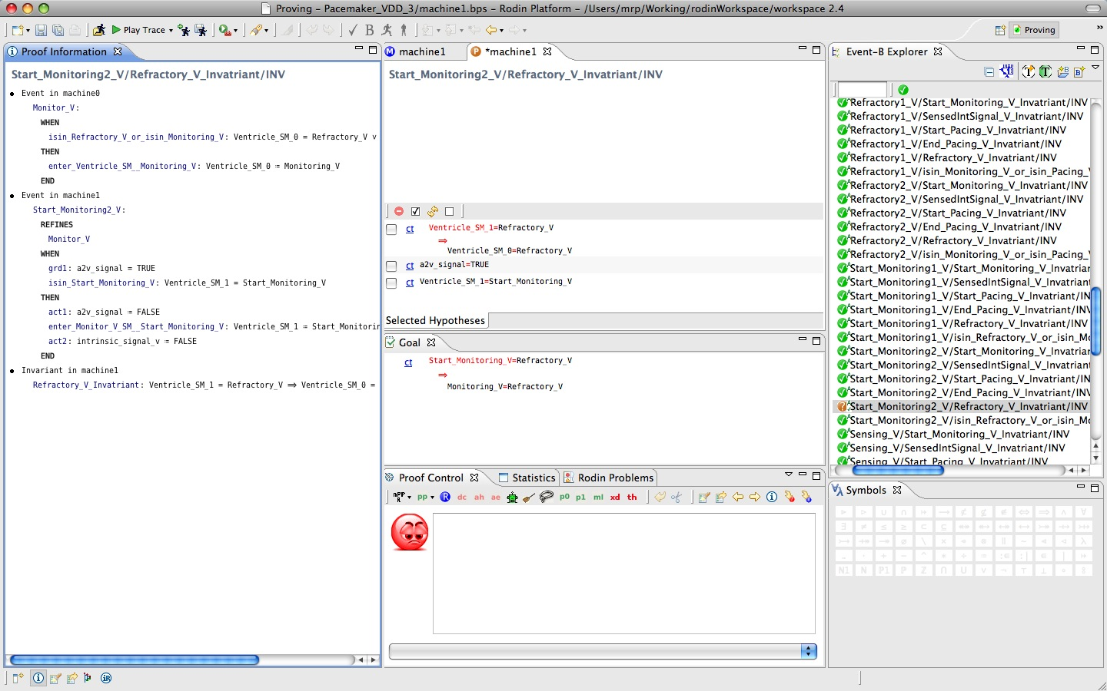
Rodin: Proving perspective: proof info, proof & control, PO explorer views:

Slide 19
Proof and model checking
Model checking: force the model to be finite state and explore state space looking for invariant violations
completely automatic
powerful debugging tool (counter-example)
(Semi-)automated proof: based on logical deduction rules
no restrictions on state space
leads to discovery of invariants that deepen understanding
not completely automatic

Slide 20
Models are created and verified iteratively
Modelling
Proof Obligations
Proving

Slide 21
Rodin architecture
Modelling
Static
Checker
Proof
Obligation
Generator
Proof Manager
Proving

Slide 22
Rodin Architecture
Extension of Eclipse IDE
Repository of structured modelling elements
Rodin Eclipse Builder manages:
Well-formedness + type checker
Consistency/refinement PO generator
Proof manager
Propagation of changes
Extension points to support plug-ins

Slide 23
Differential proving in Rodin
Models are constantly being changed
When a model changes, proof impact of changes should be minimised as much as possible:
Sufficiency comparison of POs
In case of success, provers return list of used hypotheses
Proof valid provided the used hypothesis are in the new version of a PO
Model refactoring:
Identifier renaming applied to models (avoiding name clash)
Corresponding POs and proofs automatically renamed

Slide 24
Rodin Proof Manager (PM)
PM constructs proof tree for each PO
Automatic and interactive modes
PM manages used hypotheses
PM calls reasoners to
discharge goal, or
split goal into subgoals
Collection of reasoners:
simplifier, rule-based, decision procedures, …
Basic tactic language to define PM and reasoners

Slide 25
Statistics from Flash-based file development in Event-B

Slide 26

Validation/verification offered by ProB
Animation: show behaviour of model in clear terms
Model Checking
Refinement Checking
Graphical Domain Specific Visualization
Visualization of State Space

Slide 27
ProB
Animator and model checker
search for invariant violations
search for deadlocks
search for proof obligation violations
Implementation uses constraint logic programming
makes all types finite
exploits symmetries in B types

Slide 28
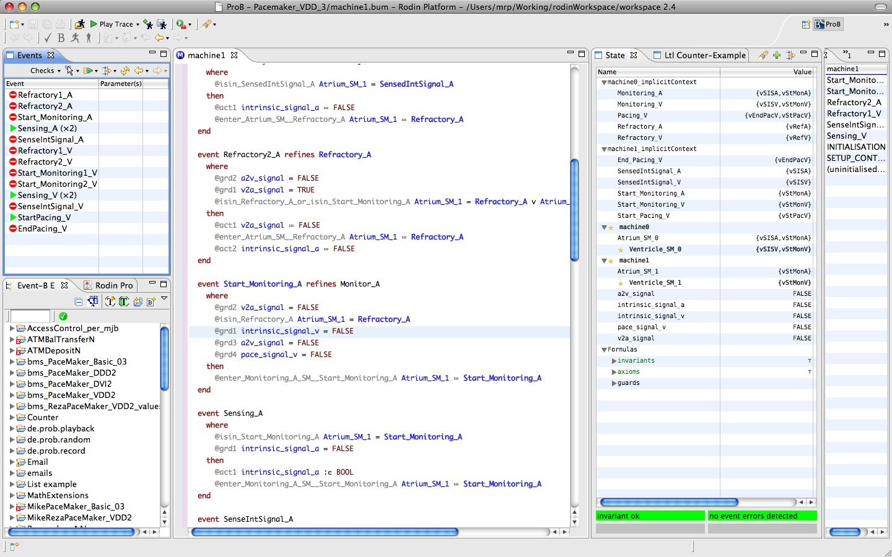
Rodin: ProB perspective: model text, ProB views:

Slide 29

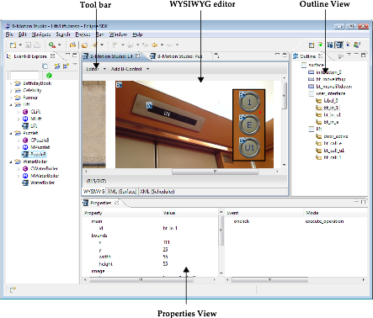
BMotionStudio
[Ladenberger et al., FMICS’09]

Slide 30
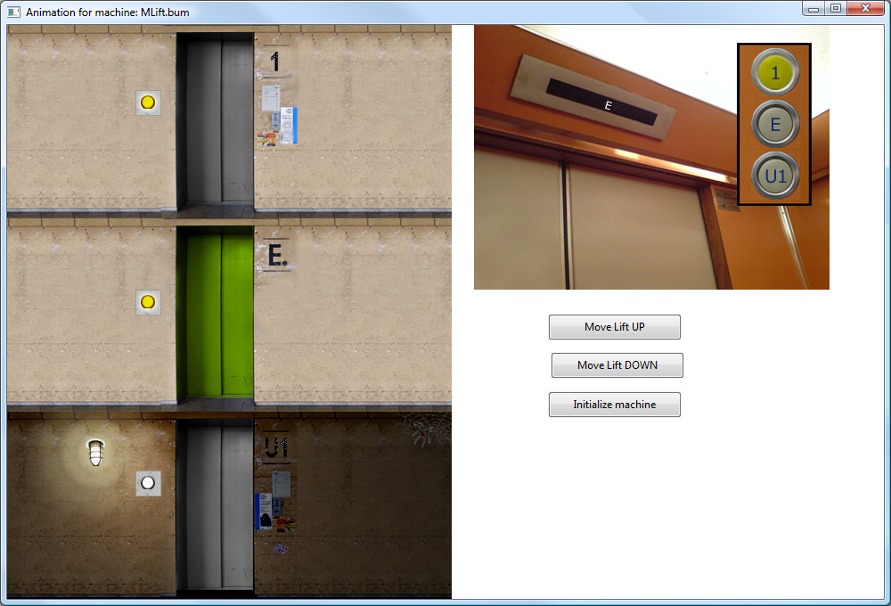

Slide 31
Rodin Toolset for Event-B
Extension of Eclipse IDE
Rodin Builder manages:
Well-formedness + type checking
Consistency/refinement PO generator
Proof manager
Propagation of changes
Extension points to support plug-ins

Slide 32
Rodin Proof Manager (PM)
PM constructs proof tree for each PO
Automatic and interactive modes
PM calls reasoners to
discharge goal, or
split goal into subgoals
Basic tactic language to adapt PM
Collection of reasoners:
simplifiers, rule-based, decision procedures

Slide 33
Range of Automated Provers
Built-in: tactic language, simplifiers, decision procedures
AtelierB plug-in for Rodin (ClearSy, FR)
SMT plug-in (Systerel, FR)
Isabelle plug-in (Schmalz, ETHZ)

Slide 34
Supporting model changes
Models are constantly being changed
When a model changes, proof impact of changes should be minimised as much as possible:
Sufficiency comparison of POs
In case of success, provers return list of used hypotheses
Proof valid provided the used hypothesis in new version of a PO
Renaming:
Identifier renaming applied to models (avoiding name clash)
Corresponding POs and proofs automatically renamed

Slide 35
Proof and model checking
Model checking: force the model to be finite state and explore state space looking for invariant violations
☺ completely automatic
☺ powerful debugging tool (counter-examples)
state-space explosion
(Semi-)automated proof: based on deduction rules
☹ not completely automatic
☺ leads to discovery of invariants - deepen understanding
☺ no restrictions on state space

Slide 36
Some references
Full introduction to modelling and verification in Event-B, to advanced level (including definition of proof obligations):
Jean-Raymond Abrial. Modeling in Event-B: System and Software Engineering. Cambridge University Press 2010
Abrial, Butler, Hallerstede, Hoang, Mehta and Voisin
Rodin: An Open Toolset for Modelling and Reasoning in Event-B.
International Journal on Software Tools for Technology Transfer (STTT), 12 (6), 2010.
Leuschel and Butler
ProB: An Automated Analysis Toolset for the B Method. International Journal on Software Tools for Technology Transfer, 10, (2), 185-203, 2008.

Slide 37
Rodin and its plug-ins: read about and install via www.event-b.org
ProB model checker:
consistency and refinement checking
External provers:
AtelierB plug-in for Rodin (ClearSy, FR)
SMT plug-in (Systerel, FR)
Isabelle plug-in (Schmalz, ETHZ)
Theory plug-in – user-defined mathematical theories
UML-B: Linking UML and Event-B
Graphical model animation
ProB, AnimB, B-Motion Studio
Requirements management (ProR)
Team-based development
Decomposition
Code generation
…

Slide 38
END

